Slide 1
Checking understanding of multiplication with fractions
Arithmetic procedures with fractions

Slide 2
how to use Oak lessons

Slide 3
I can use the mathematical structures that underpin the multiplication of fractions.

Slide 4

Numerator − The expression in a fraction that is written above the fraction line. It is the dividend.
Denominator − The expression in a fraction that is written below the fraction line. It is the divisor.
numerator
denominator

Slide 5

Checking understanding of multiplication with fractions
Exploring the area model
Multiplication of fractions

Slide 6
Exploring the area model
Each of these large squares has an area of 1 m².
What is the area of each shaded section?
Notes:
NCETM checkpoint

Slide 7

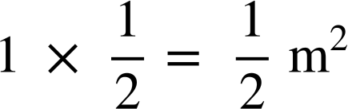
Exploring the area model
m
The shape is split into 2 equal parts.
1 m
1 equal part is shaded.
of the square is shaded.

Slide 8
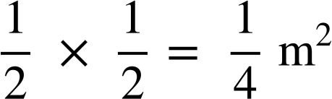
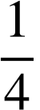
Exploring the area model
m
The shape is split into 4 equal parts.
m
1 equal part is shaded.
of the square is shaded.

Slide 9

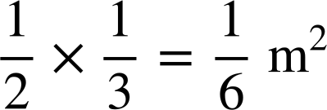

Exploring the area model
m
The shape is split into 6 equal parts.
m
1 equal part is shaded.
of the square is shaded.

Slide 10
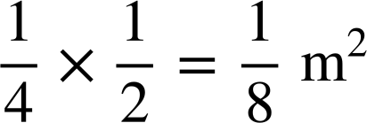
Exploring the area model
m
m
The shape is split into 8 equal parts.
1 equal part is shaded.
of the square is shaded.

Slide 11
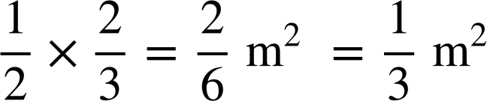
Exploring the area model
m
The shape is split into 6 equal parts.
m
2 equal parts are shaded.
of the square is shaded.

Slide 12
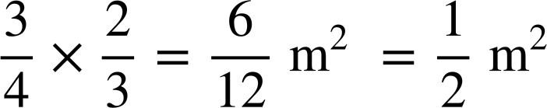
Exploring the area model
m
The shape is split into 12 equal parts.
m
6 equal parts are shaded.
of the square is shaded.

Slide 13
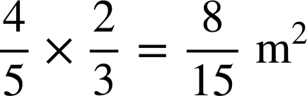
Exploring the area model
m
The shape is split into 15 equal parts.
m
8 equal parts are shaded.
of the square is shaded.

Slide 14
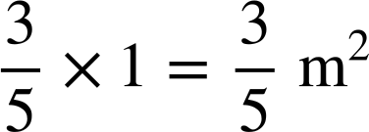

Exploring the area model
1 m
The shape is split into 20 equal parts.
m
12 equal parts are shaded.
of the square is shaded.

Slide 15
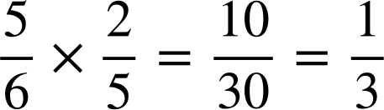
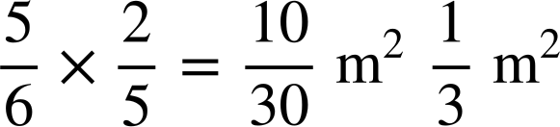
Exploring the area model
Fill in the blanks:
m
The
shape
is
split
into
30 equal parts .
m
10 equal parts are shaded.
of the square is shaded.

Slide 16
Exploring the area model
1) Each of the large squares have an area of 1 m². For each square:
a) Label the dimensions of the shaded rectangle
b) Write the calculation represented by the area of the shaded rectangle.
c) Work out the area of the square that is shaded.
v)

Slide 17
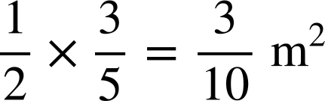
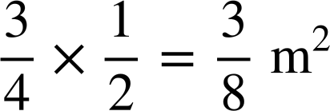
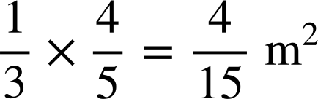
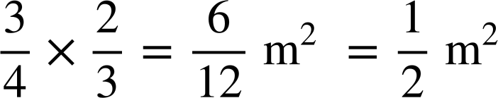
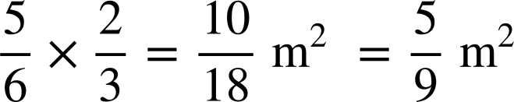
Exploring the area model
1) Each of the large squares have an area of 1 m². For each square:
a) Label the dimensions of the shaded rectangle
b) Write the calculation represented by the area of the shaded rectangle.
c) Work out the area of the square that is shaded.
v)

Slide 18
Checking understanding of multiplication with fractions
Exploring the area model
Multiplication of fractions

Slide 19
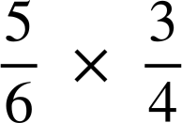
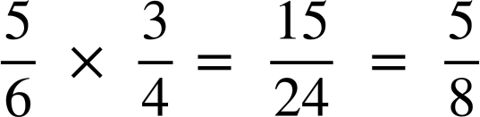
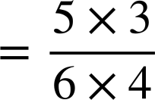
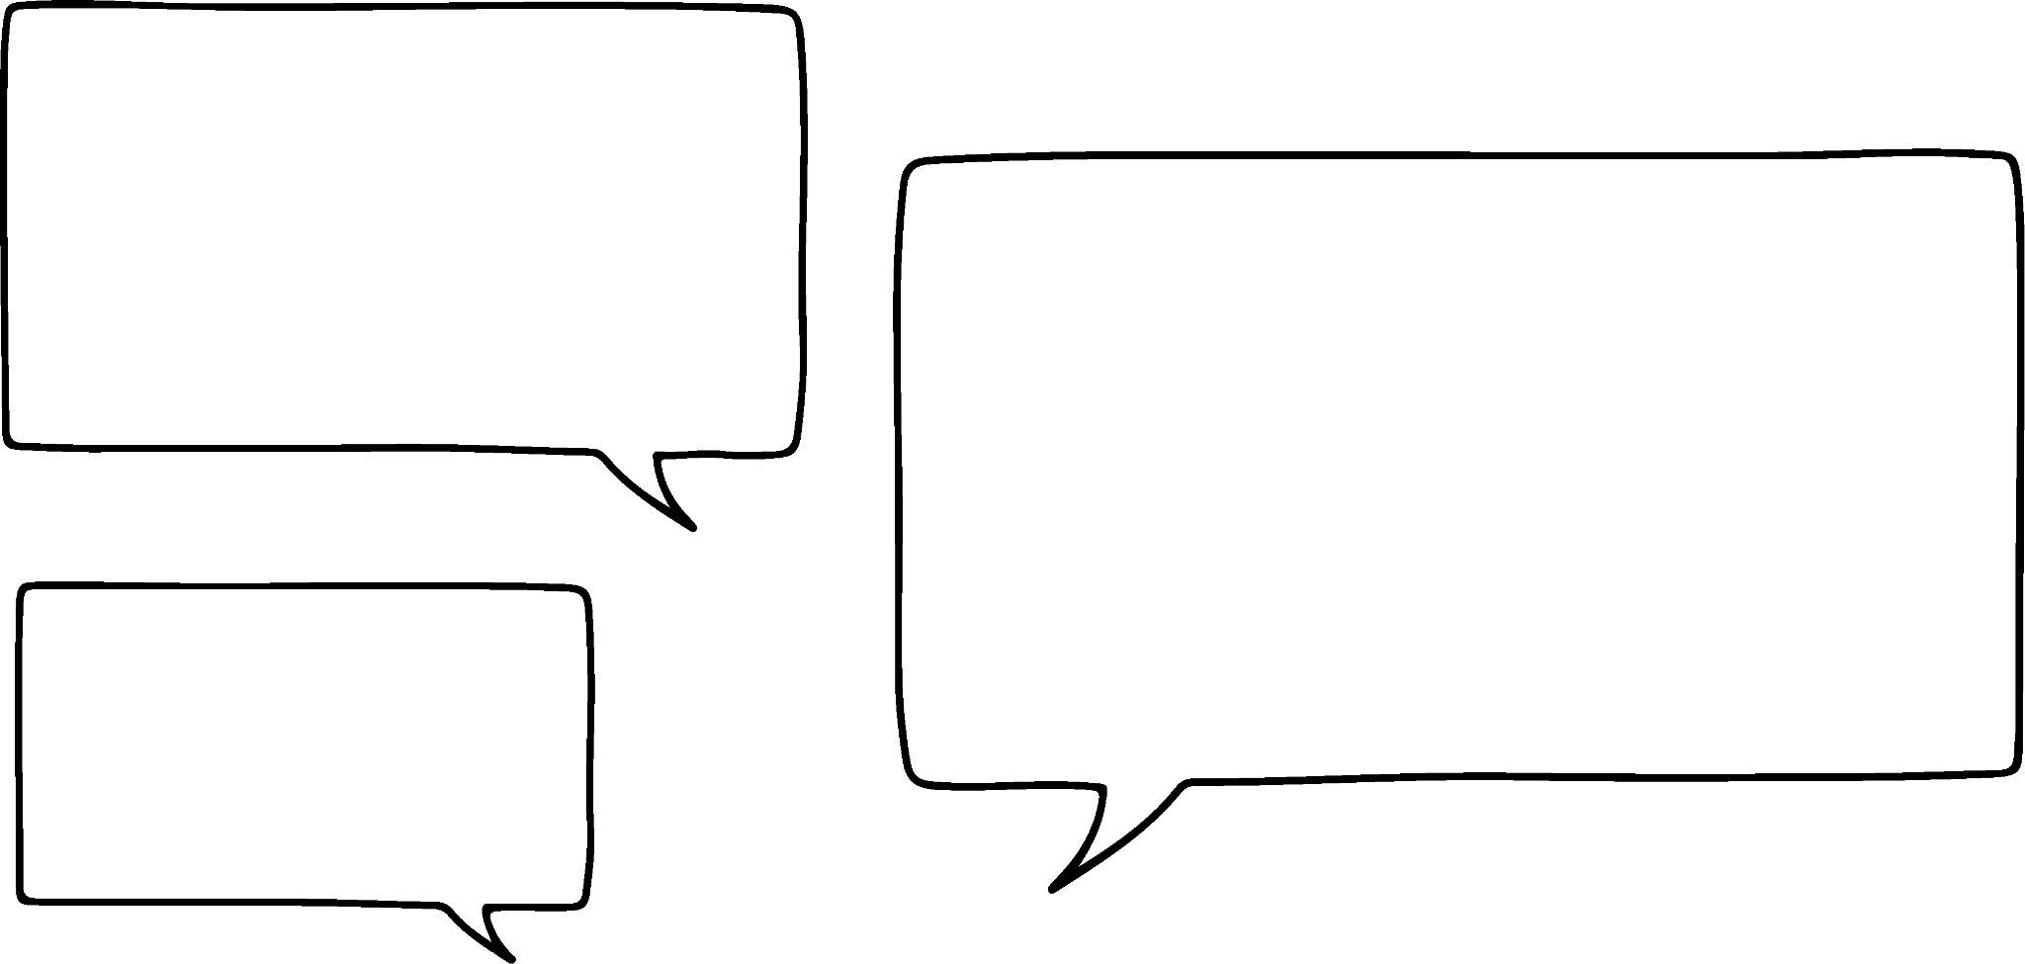

Multiplication of fractions
What would the diagram to represent this calculation look like?
It looks like you just multiply the numerators together and denominators together.
Do you agree with Sofia?
Sofia

Slide 20
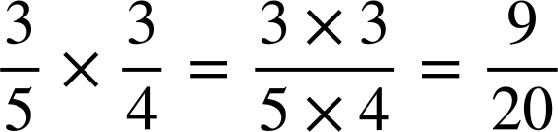
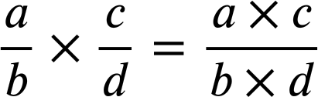
Multiplication of fractions
When multiplying two proper fractions you multiply the numerators to get the numerator of the product and multiply the denominators to get the denominator.
c
e.g.
a
b
In general,
d

Slide 21
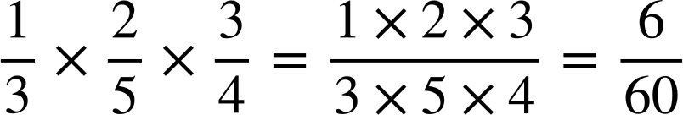
Multiplication of fractions
Sofia is interested to know if you had more than two fractions if you would still just do the same.
What do you think?

Slide 22
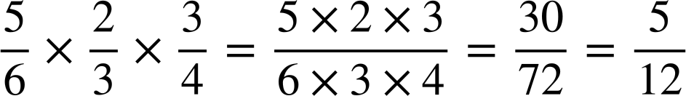
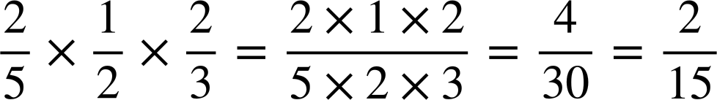
Multiplication of fractions
Calculate the answer to
Give your answer in its simplest form.
Calculate the answer to
Give your answer in its simplest form.

Slide 23
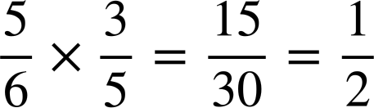
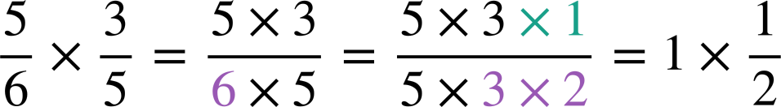
Multiplication of fractions
You may have noticed that some products need simplifying.
You can simplify before multiplying to be more efficient.
We could have noticed some common factors to simplify first.

Slide 24
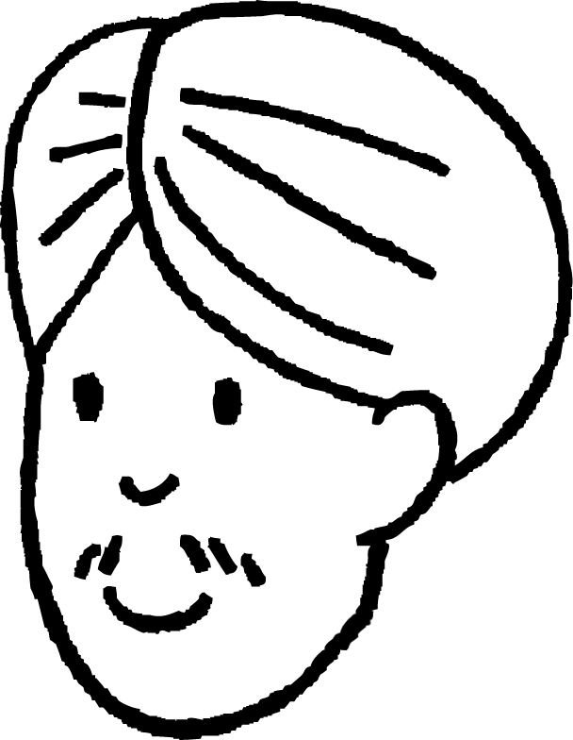
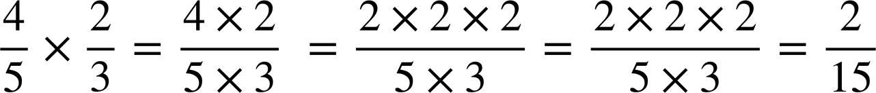
Multiplication of fractions
Andeep tried to simplify this calculation before multiplying.
Now I can cancel the 2s
What mistake has he made?
This does not simplify to . Andeep has tried to take out common factors just of the numerator.
We can simplify if the factors are common to the numerator and denominator.

Slide 25
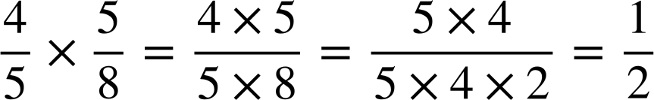

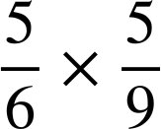
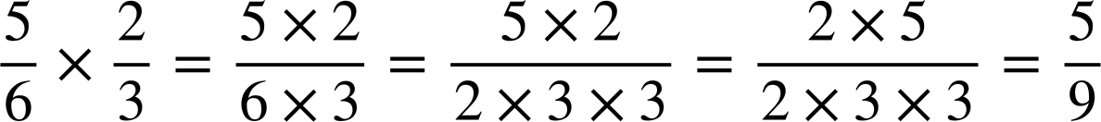
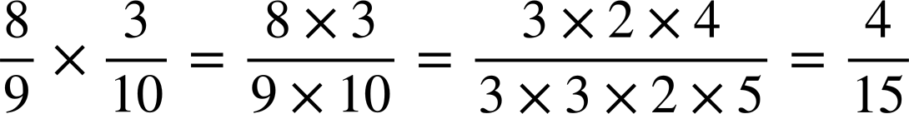
Multiplication of fractions
Which of these could you simplify before multiplying?

Slide 26
Multiplication of fractions
Calculate these by simplifying first. Show the steps you took.

Slide 27
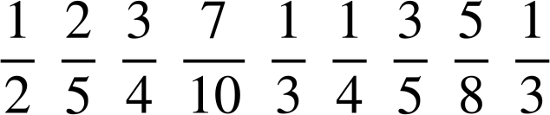
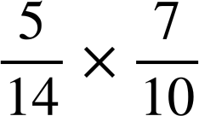
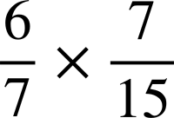
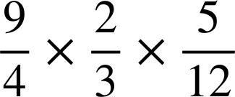
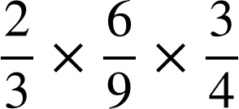
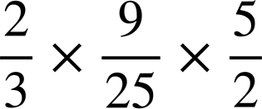
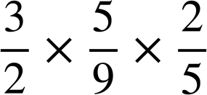
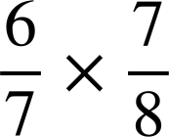
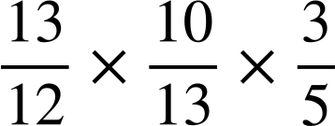
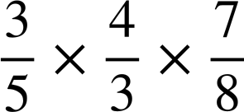
Multiplication of fractions
1) Calculate the answers to the following. Simplify all answers. Find them in the table and write down which letter each gives. Rearrange your letters to make a word.
A | B | C | D | E | F | G | H | I | J | K | L | M
N | O | P | Q | R | S | T | U | V | W | X | Y | Z
a)
b)
c)
d)
e)
f)
g)
h)
i)

Slide 28
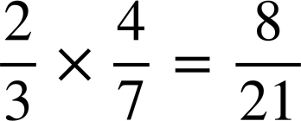
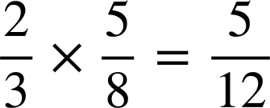
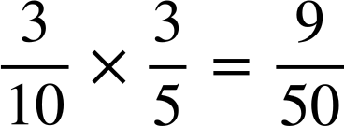
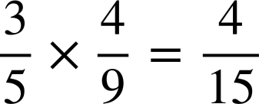
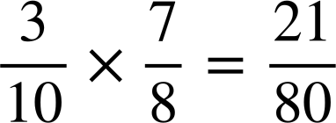
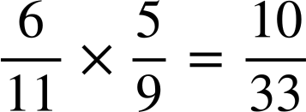
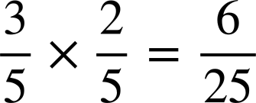

Multiplication of fractions
2) What are the missing digits in the following calculations?
a)
b)
c)
d)
e)
f)
g)
h)

Slide 29

Multiplication of fractions
1) Calculate the answers to the following. Simplify all answers. Find them in the table and write down which letter each gives. Rearrange your letters to make a word.
A | B | C | D | E | F | G | H | I | J | K | L | M
N | O | P | Q | R | S | T | U | V | W | X | Y | Z
a)
b)
A
c)
d)
U
e)
f)
O
g)
h)
R
i)
T
The word is NUMERATOR
R
M
N
E

Slide 30
Multiplication of fractions
2) What are the missing digits in the following calculations?
a)
b)
c)
d)
e)
f)
g)
h)

Slide 31
Checking understanding of multiplication with fractions
When multiplying a fraction by a fraction you multiply across the numerators and across the denominators.
E.g.

Slide 32

© Oak National Academy 2023.
Produced in partnership with Mathematics in Education and Industry.
Licensed on the Open Government Licence v3.0, except where otherwise stated. See Oak terms and conditions.

